Slide 1
Introduction to compiler
By:
Trusha R. Patel
Asst. Prof.
CE Dept., CSPIT, CHARUSAT

Slide 2
Basic
Software running on all computers was written in some programming language
Before a program can run, it first must be translated into a form in which it can be executed by a computer
This translation is done by compiler

Slide 3
Compiler
Language processor
It is a program reads a program written in source language and translates it into an equivalent program in target language
Its main role is to report errors during translation process
It target program is executable machine code then it take input and gives output
Input
Compiler
Source program
Target
program
Output

Slide 4
Interpreter
Language processor
Not produce target program as result like translator
Directly execute the operations specified in the source program on input
Source program
Interpreter
Output
Input

Slide 5
Compiler vs. Interpreter
Compiler
  Machine-language target program generated by a compiler is usually much faster at mapping input to output
Interpreter
  Interpreter usually give better error diagnostics

Slide 6
Java Language Processor
Combines compilation and interpretation
Java source program
Translator
Intermediate program
(bytecode)
Interpreter
Output
Input

Slide 7
Language Processors
Source program may be divided into modules (stored in different files)
Task of collecting source program and expansion of shorthand (macro) is done by Preprocessor
Modified program is given to Compiler that produce an assembly-language program as output
Assembly-language program is processed by Assembler and generate relocatable machine code

Slide 8
Language Processors
Large programs are often compiled in pieces, so relocatable machine code may have to be linked together which is done by Linker
It resolves external memory address
Loader puts all of executable object files into memory for execution

Slide 9
Language Processors
Source program
Preprocessor
Library files
Relocatable object files
Modified
source program
Compiler
Target
assembly program
Assembler
Relocatable
Machine code
Loader/Linker
Target machine code

Slide 10
Structure of Compiler
Compiler
Analysis
Synthesis

Slide 11
Structure of Compiler
Compiler
Analysis
Synthesis
Break source program into pieces
Check grammatical structure
Give error ( if any )
Store information in symbol table
Generate intermediate representation (IR)

Slide 12
Structure of Compiler
Compiler
Analysis
Synthesis
Construct target program from IR and information in Symbol table

Slide 13
Structure of Compiler
Compiler
Analysis
IR
Synthesis
Source program
Target program
Error

Slide 14
Structure of Compiler
Compiler
Front end
IR
Back end
Source program
Target program
Error

Slide 15
Structure of Compiler
Phase
  Compiler operates as a sequence of individual logical unit called phase, each of which translates one representation of the source program to another.

Slide 16
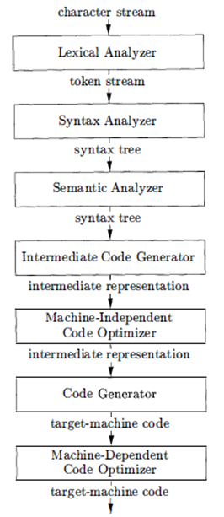
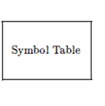
Phases of Compiler

Slide 17
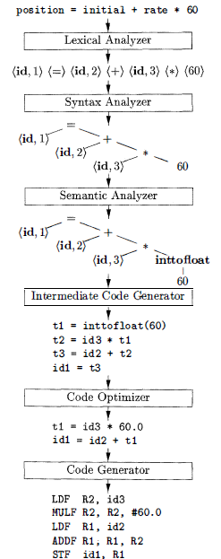
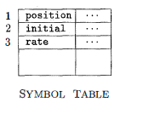
Translation of Assignment Statement

Slide 18
Phase-1 : Lexical Analysis
Lexical analysis is also called scanning
Reads the stream of characters and group the characters into meaningful sequence called lexemes and for each lexeme produce token in given form
< token-name , attribute-value>
pointer to an entry in symbol table for token
abstract symbol that is used during syntax analysis

Slide 19
Phase-2 : Syntax Analysis
Syntax analysis is also called parsing
Creates tree-like intermediate representation that determines the grammatical structure of the token
Typical representation is syntax tree in which interior node represents an operation and the children of the nodes represents the arguments of the operation

Slide 20
Phase-3 : Semantic Analysis
Uses syntax tree and information in symbol table
Check the source program for semantic consistency
Important part of semantic analysis is type checking
Some language may support coercion
(e.g. internal type casting in C)

Slide 21
Phase-4 : Intermediate Code Generation
After syntax and semantic analysis many compiler generate an explicit low-level or machine-like intermediate representation (IR)
Two important properties of IR
  Should be easy to produce
  Should be easy to translate into target machine code

Slide 22
Phase-5 : Code Optimization
It attempts to improve the intermediate code so that better target code will result
Generate shorter IR, which can convert faster in target code

Slide 23
Phase-6 : Code Generation
Takes IR as input and maps it into the target language

Slide 24
Grouping of Phases
Phases deals with the logical organization of a compiler
Phases may be grouped together into a pass that reads an input file and generate an output file
Front-end phases (lexical analysis, syntax analysis, semantic analysis, intermediate code generator) might be grouped together into one pass
Back-end phases (code optimizer, code generator) are grouped into second pass

Slide 25
Grouping of Phases
Front-end phases : independent of machine
dependent on language
Back-end phases : dependent on machine
Intermediate representation (IR) provides interface between front-end and back-end
Which this collection it is possible to produce compiler for different source language for one target machine

Slide 26

Grouping of Phases
Source language
1
Source language
2
Source language
3
Front-end phases
Front-end phases
Front-end phases
IR
IR
IR
Back-end phases
Machine code

Slide 27


Grouping of Phases
Source language
Front-end phases
IR
Back-end phases
Back-end phases
Back-end phases
Machine code - 1
Machine code - 2
Machine code - 3

Slide 28
Compiler Construction Tools
Parser generators
  Automatically produce syntax analyzers from grammatical description
Scanner generators
  Produce lexical analyzers from regular expression description
Syntax-directed translation engines
  Produce collections of routines from parse tree and generate intermediate code

Slide 29
Compiler Construction Tools
Code-generator generators
  Produce code generator from collection of rules for translating each operation of intermediate language into machine language for target machine
Data-flow analysis engines
  Gather information about how data values are transmitted from on part of the program to other part
Compiler-construction toolkits
  Provide integrated set of routines for constructing various phases of compiler

Slide 30
END

